Slide 1
Polynomial Regression

Slide 2

What is a Polynomial?
A polynomial is an algebraic expression
An equation representing relationship between variables
Written as a mathematical expression of variables, constants, and exponents .
Number of roots (or solutions) is less than or equal to the highest power of a variable.
Assists in predicting outcomes
Exponent
Constant
$$ax2+by+c$$
Variables
Coefficients
Operators

Slide 3
What is not a polynomial?
An algebraic expression that contains
fractional exponents
negative exponents (example: 3X – 4X⁻²)
Division by a variable (example: 3/x + 4X²)
Radicals (an integer under * root, * square, cube, etc.)

Slide 4
N-th degree Polynomial
Y = a₀ + a₁*x + a₂*x² + a₃*x³ + … + a_{n}x^{n}
The power “n” of the polynomial Y is the degree of the polynomial
n = 1 (linear): Y = a₀ + a₁ * x
n = 2 (quadratic): Y = a₀ + a₁ * x + a₂ * x²
n = 3 (cubic): Y = a₀ + a₁ * x + a₂ * x² + a₃ * x³
…
Goal: pick the appropriate n to fit the data.

Slide 5
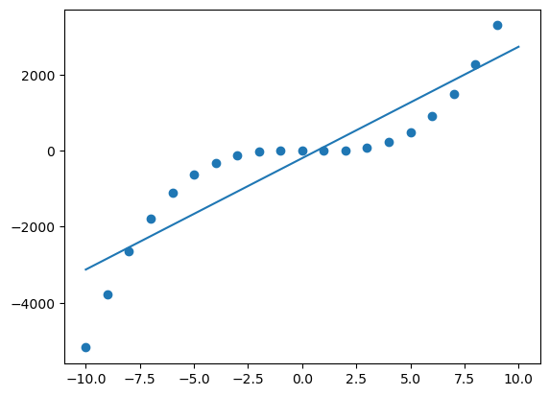
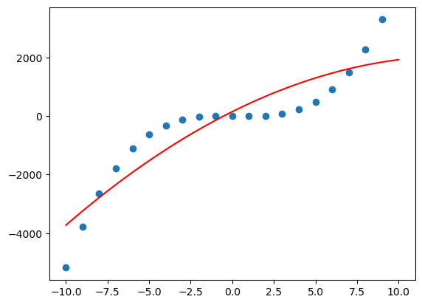
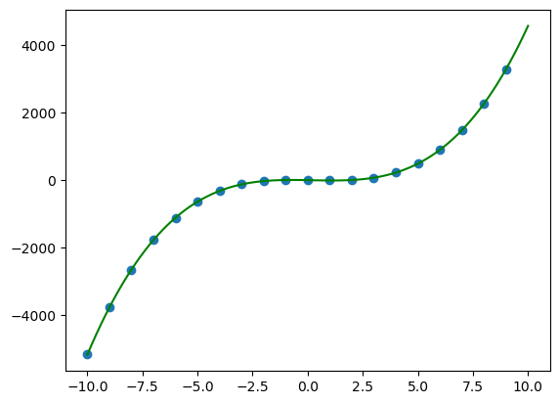
Accuracy of a Fit
Y = 5x³ – 3x² -12x
Degree n = 1
Degree n = 2
Degree n = 3
MSE (Mean Squared Error). The average squared difference between predicted and actual values
RMSE (Root Mean Squared Error) Square root of MSE. RMSE is more commonly used because its in the same units as your prediction.

Slide 6
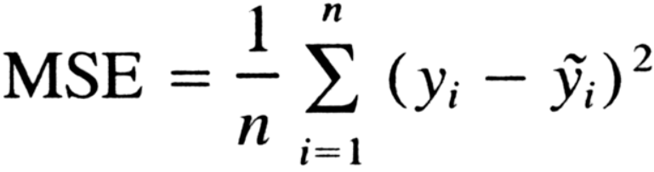

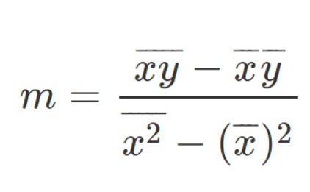
Mean Square Error Computation
(x6,y6)
RMSE = Sqrt (MSE)
(x4,y4)
Intercept: b
(x3,y3)
(x5,y5)
(x7,y7)
Y
(x1,y1)
Slope: m
(x2,y2)
X

Slide 7
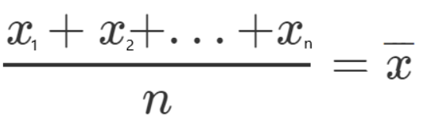
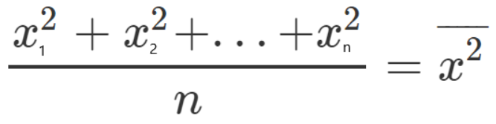
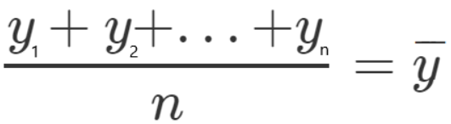
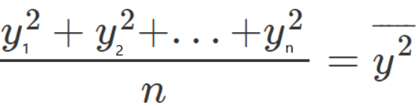
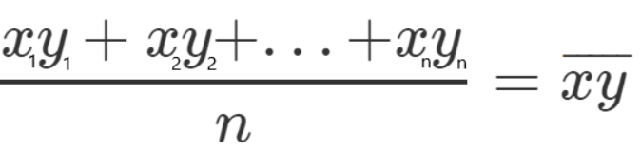
Average of terms and cross-terms

Slide 8
Tutorials
Polynomial Regression

